Slide 1



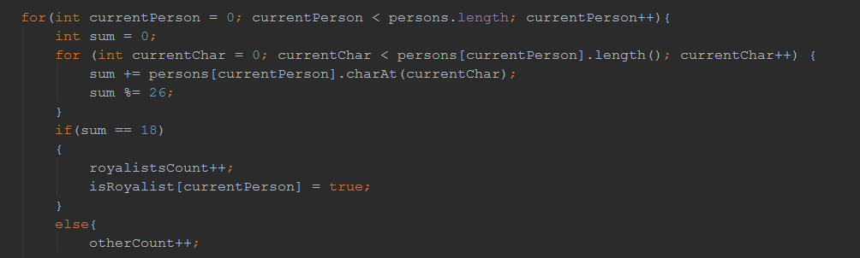
Java Advanced
Course Introduction
Java
SoftUni Team
Technical Trainers
Software University
http://softuni.bg

Slide 2
Questions
sli.do #JavaAdvanced

Slide 3









SoftUni Diamond Partners

Slide 4
Java Web Profession
Java Fundamentals Module
Java Advanced Course
~9,000,000 Developers Worldwide
~700 Offers @ Jobs.BG
Scope
Trainers
Evaluation

Slide 5
Java Web Profession
Java Fundamentals Module
Java Advanced Course
Algorithmic and Conceptual Courses
Prelude to Database and Web Technology Courses
Scope
Trainers
Evaluation

Slide 6
Java Web Profession
Standard Java API
Java Fundamentals Module
Algorithmic thinking
Java Advanced Course
Scope
Trainers
Evaluation

Slide 7
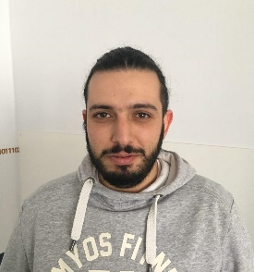


Java Advanced Course
Scope
Trainers
Evaluation

Slide 8
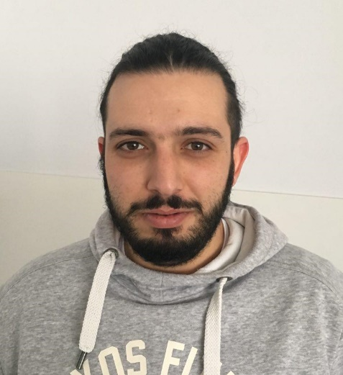
Trainers Team
Ventsislav Ivanov
Telerik Academy Graduate 2016
Knowedge at web testing
Experience as QA engineer

Slide 9

Trainers Team
Peter Penev
Technical Trainer @ Software University
Top performing student from the Software University
Deep interest in Data Structures & Algorithms

Slide 10

Trainers Team
Ivan Ivanov
Top performing student (2015)
Interests in back-end web development, Spring, Vert.x and Java Technologies in general
Develops APIs and Libraries in his spare time

Slide 11
Trainers
Java Advanced Course
Scope
Evaluation

Slide 12
Examination
Activities
Bonuses
Forum Activity
Nested Linear Structures
Attendance
Algorithmic Problem
Java Advanced Course
75%
25%
10%
Nested Data Structures
10%
String Processing
Scope
10%
5%
Trainers
Evaluation
Teamwork Project
Exercises
Labs

Slide 13
Java Web Profession
Java Fundamentals Module
Java Advanced Course
Scope
Trainers
Evaluation

Slide 14


Your RFID Chip
Students can either
Take RFID chip from SoftUni
Or use their own chip / card
Register your chip number in your SoftUni profile: https://softuni.bg/users/profile/show
Check-in at the reception every time when you come
See your last visits in your profile: https://softuni.bg/users/profile/show

Slide 15









Resources
What We Need Additionally?

Slide 16

Course Web Site & Forums
The Java Advanced official web page:
Register for the "Software University Forum":
Discuss the course exercises with your colleagues
Find solutions for all course exercises
Share source code / discuss ideas / help each other
https://softuni.bg/courses/java-fundamentals
http://softuni.bg/forum

Slide 17



The Java Advanced Slides and Videos
All lecture slides, videos, exercises, projects and other resources are open content, available for free
Visit the course web site to access the course resources

Slide 18
The Free Java Fundamentals Textbook
The official textbook for the course
„Въведение в програмирането с Java", by Svetlin Nakov & Co., 2009, ISBN 9789544000554
Bulgarian versions (as PDF, ePub, …)
Freely downloadable from: www.introprogramming.info

Slide 19


Required Software
Software needed for this course:
Microsoft Windows (Win 10 / 8.1 / Win8 / Win7)
JetBrains IntelliJ Idea
JDK 8 (Java Development Kit)

Slide 20
Java Advanced – Course Intro
https://softuni.bg/courses/java-fundamentals

Slide 21
License
This course (slides, examples, demos, videos, homework, etc.) is licensed under the "Creative Commons Attribution-NonCommercial-ShareAlike 4.0 International" license
Attribution: this work may contain portions from
"Fundamentals of Computer Programming with Java" book by Svetlin Nakov & Co. under CC-BY-SA license

Slide 22






Free Trainings @ Software University
Software University Foundation – softuni.org
Software University – High-Quality Education, Profession and Job for Software Developers
softuni.bg
Software University @ Facebook
facebook.com/SoftwareUniversity
Software University @ YouTube
youtube.com/SoftwareUniversity
Software University Forums – forum.softuni.bg

